Slide 1
MSTRIO
By Ruchir Bhusari

Slide 2
AGENDA
01
What is MSTRIO
02
Prerequisites for MSTRIO
03
04
Tasks performed via MSTRIO
Demo on Jupyter Notebook
05
06
Pros and Cons of MSTRIO
References

Slide 3

What is MSTRIO
“
MSTRIO is a package in Python which allows us to connect to MicroStrategy with Python. Not only Python but also connects R with MicroStrategy. MSTRIO is mainly used for both Data science related Activities and administration related activities. All these activities are performed using Jupyter Notebook Integrated Development Environment. It wraps MicroStrategy REST APIs into simple workflows, allowing users to fetch data from cubes and reports, create new datasets, add new data to existing datasets, and manage Users/User Groups, Servers, Projects, and more.

Slide 4
Prerequisites for MSTRIO
For working with MSTRIO user must require :
a] Python installed in Machine (Python 3.10+)
Note: Python 3.11 is not yet officially supported
b] MicroStrategy with at least 10.11 version (2019 update 4). Developer and Web are Mandatory , workstation is Optional.

Slide 5
4 Essential Steps
1] Download Python (3.10+ version) from link given below
https://www.python.org/downloads/
2] Install Jupyter notebook using following command in command prompt:
Pip install jupyter notebook
3] Install the mstrio package by running following command in command prompt:
pip install mstrio-py
4] Install and Enable the Jupyter Notebook extension by running following commands in command prompt:
a] Installing Jupyter notebook extension:
jupyter nbextension install connector-jupyter --py --sys-prefix
b] Enabling connection:
jupyter nbextension enable connector-jupyter --py --sys-prefix

Slide 6
Tasks performed via MSTRIO
1]Project management
2]User and User Group management
3]Intelligent Cube management
4]Object management
5]Connection management
6]Dossier Management etc..
Connection management
User and User Group management
Object management
From mstrio.connection import Connection
Used for Establishing the connectivity with Intelligence server by use of Library Link and connecting with Project by using Project ID.
From mstrio.users_and_groups import list_user_groups,UserGroup ,User,list_users
Creating User
To see all users
To see all user groups
Delete user
Alter users
from mstrio.project_objects import load_cube,OlapCube,SuperCube,Report
Importing Report
Importing OlapCube
Importing SuperCube
Importing Dossier

Slide 7
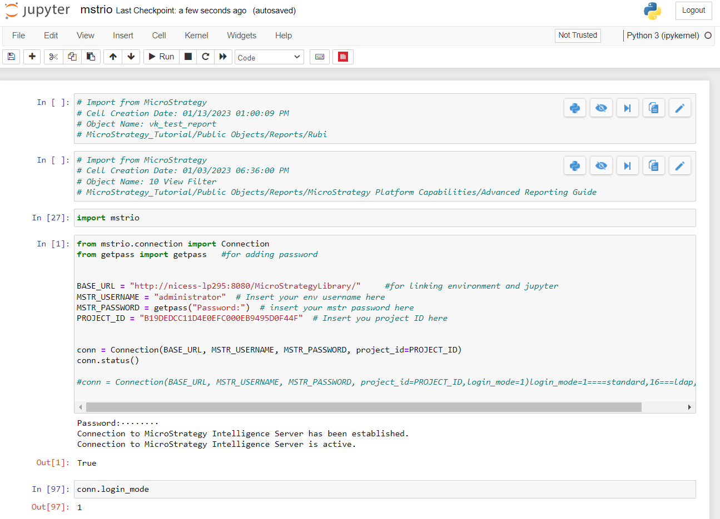
Demo On Jupyter Notebook
Summary
To establish connection with Intelligence server.
Changing Login mode
To see username of project
To see all users, user groups in Project
To check user by its ID
To see the id of user by adding name of user.
Creating new user, altering new user,
Changing user name, password and full name of user
Importing Report
Creating attributes and metrics and storing attribute and metric elements
To see attributes, Metrics and attribute elements in a report.
Adding Data to DataFrame
Creating new project
Filtering data from report

Slide 8

Pros and Cons of MSTRIO
Pros
Can integrate machine learning and data science using MSTRIO package in python.
We can use multiple API’s using MSTRIO in Python.
Less time required for report execution and importing.
Code reusability is possible.
It’s easy to integrate business data in machine learning workflows and enable decision-makers to take action on predictive insights in MicroStrategy Reports, Dossiers, Hyper Intelligence Cards.
Cons
Cannot use for Dossier and RSD visual Formattings.
IDs are used in MSTRIO which is inconvenient.
Updating Datasets that were not created using the MicroStrategy REST API is not possible. This applies for example to Cubes created via MicroStrategy Web client.

Slide 9
References
1] https://pypi.org/project/mstrio-py/
2] https://youtu.be/H9Pi-cob7Bo

Slide 10
Workstation
MicroStrategy Workstation is a powerful tool that combines features of MicroStrategy Developer and MicroStrategy Web. Workstation makes it easy to build compelling visualizations and interactive dossiers and RSDs then easily share those dossiers with others.
HyperIntelligence is the additional feature which is available in Workstation through which we can create Hyper Cards.
Inclusion of different MicroStrategy tools in Workstation like we can write command manager scripts , we can migrate objects thus plays a role of Command manager and Object Manager as well.

Slide 11




THANK YOU
Securing your future with quality data and analysing with precision.​
+91 8007861579
21, IT Park, Gayatri Nagar, behind VNIT, Nagpur – 440022
info@nicesoftwaresolutions.com
www.nicesoftwaresolutions.com

